Slide 1


Client Development with .NET 6
Isaac Levin
Notes:
Welcome to .NET Conf – Focus on Windows! We’re very excited to bring you another event that focuses on specific things you can do with .NET. Today, we’re going to talk all about Windows desktop development.

Slide 2





.NET – A unified platform
TOOLS
DESKTOP
WEB
CLOUD
MOBILE
GAMES
IoT
AI
VISUAL STUDIO
VISUAL STUDIO FOR MAC
.NET
LIBRARIES
VISUAL STUDIO CODE
INFRASTRUCTURE
CLI
RUNTIME COMPONENTS
COMPILERS
LANGUAGES
Notes:
We’ve made significant advancements in the platform since it was open sourced in 2014. Together, Microsoft and the community has extended the capabilities of .NET to cover workloads we never had before, like Linux workloads and Machine Learning & AI. And we’ve got a full set of tools with the Visual Studio family all with great support for .NET.
<CLICK>

Slide 3
.NET – A unified platform
TOOLS
WINDOWS DESKTOP
WEB
CLOUD
MOBILE
GAMES
IoT
AI
VISUAL STUDIO
VISUAL STUDIO FOR MAC
.NET
LIBRARIES
VISUAL STUDIO CODE
INFRASTRUCTURE
CLI
RUNTIME COMPONENTS
COMPILERS
LANGUAGES
Notes:
Today we’re going to focus on Windows desktop apps and how to bring them forward to the modern .NET 5 platform.
<CLICK>

Slide 4





Controls for Windows apps on .NET 7
PARTNERS
Notes:
.NET has a rich ecosystem of partners building additional tools and controls to help you build beautiful, full-featured, applications faster. We have many partners releasing support for Winforms, and WPF on .NET 5 in their tools and controls as well. SyncFusion, Progress Telerik, Infragistics, GrapeCity and DevExpress all have great controls for multiple app models for .NET 5. Most of them are also supported in the designer today and more are coming with designer support soon.
THANK YOU!!
<CLICK>
Notes:
Telerik: Full design-time support
GrapeCity: Our .NET 5 controls do support the designer already, and we are working to support .NET Framework controls in the .NET 5 designer. We want customers to move to .NET 5 controls which 100% support the designer.
Infragistics: Yes, we have .NET 5 controls for WPF, Windows Forms, Blazor, and MVC. Design time for WPF (released last year) and Windows Forms (customers have access in release beta, might RTM next month), Tag Helpers across all the MVC / web products. See: https://www.infragistics.com/community/blogs/b/infragistics/posts/announcing-infragistics-ultimate-20-2-what-s-new.
Syncfusion: Yes, we can confirm that we are working on designer support.
DevExpress: Yes, we are working on designer support.

Slide 5
Why .NET 7 for Windows apps?
Enhanced development experience in Visual Studio
Self-contained, single file EXEs
Flexible deployment; side-by-side, ClickOnce
Latest language & API enhancements
Modern controls like WebView2
Third-party tools and controls
.NET
Notes:
We know there are millions of Windows desktop applications out there written many years ago that are still business critical today that are being actively developed. We want to make sure these apps not only run on the latest .NET but can also be developed with the latest version of Visual Studio. That’s why we’ve worked to bring these workloads to .NET Core and now .NET 5.
With .NET 5, we’ve completed this work by bringing the full Visual Studio development experience to you, including third-party control and component vendors you may be using today, and clickonce installer support. By moving forward, these apps can get all the benefits of .NET 5 like self-contained, single file EXEs that don’t need the .NET Framework on the machine. You decide when you want to update, not the Windows OS. You can also use new, modern Windows 10 controls like WebView2, a modern browser control based on Microsoft Edge Chromium.
Now we know it can be time consuming porting your applications from .NET Framework to the latest .NET versions. How can you get here more quickly?
<CLICK>

Slide 6
Windows Forms on .NET 7

Slide 7
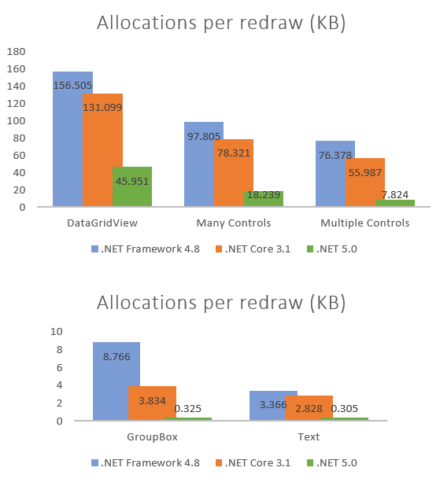
What’s new in Windows Forms?
Performance improvements
Visual Basic support
New and updated controls
ClickOnce Deployment
Modern Browser Control (WebView2)
Accessibility improvements
SDK for third-party control vendors in preview
Notes:
Performance – We refactored the old WinForms code to use GDI instead of GDI+ where possible and benefit from newer APIs. These optimizations resulted significant reduction in memory consumptions in redraw paths, in some cases saving x10 in memory allocations. (blog post: https://devblogs.microsoft.com/dotnet/whats-new-in-windows-forms-runtime-in-net-5-0/#performance-improvements)
Visual Basic (blog post: https://devblogs.microsoft.com/dotnet/visual-basic-winforms-apps-in-net-5-and-visual-studio-16-8/)
New and updated controls - New TaskDialog control and improvements in ListView (blog post: https://devblogs.microsoft.com/dotnet/whats-new-in-windows-forms-runtime-in-net-5-0/#windows-controls-additions-and-enhancements)
Accessibility – updated controls to meet today’s accessibility requirements (blog post: https://devblogs.microsoft.com/dotnet/whats-new-in-windows-forms-runtime-in-net-5-0/#accessibility-improvements-and-fixes)
SDK for third-party control - we are working with the control vendors on our SDK and making great progress together. (16.9 RTM)

Slide 8
WPF on .NET 7

Slide 9
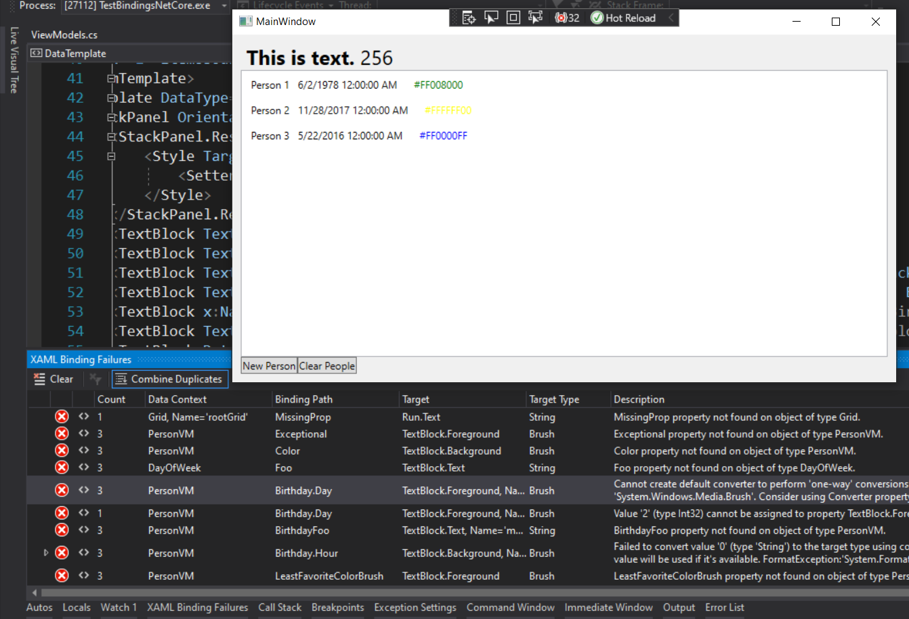
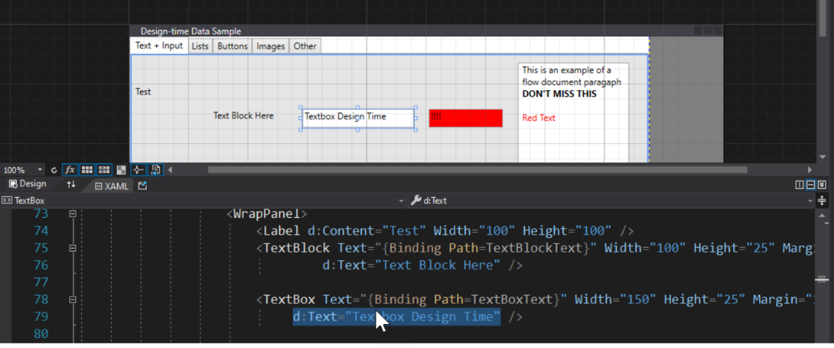
What’s new in WPF?
XAML Hot Reload Improvements
Data Binding Failure Detection & Diagnostics Experience
Simplified Design-time Data using d: (XAML Designer)
IntelliSense Improvements for MVVM scenarios
ClickOnce Deployment & Modern Browser Control (WebView2)
Notes:
For WPF customers we've tackled one of the top customers asks, bringing back ClickOnce for deployment and it's available as you already know for both Windows Forms and WPF developers targeting .NET 5. Similarly WebView2 is also available to bring the modern web control story for WPF developers as well.
In addition customers targeting .NET 5 get many new XAML tooling enhancements, this includes:
Our ever improving XAML Hot Reload feature that makes it possible for you to update your apps UI while the app is running with real data
The new data binding diagnostic experiences that makes sure you don't miss binding failures in your app and are able to navigate right to where the error is located in your XAML
The new and easy to use 'design-time data using d:' for XAML designer, this makes it possible for you to quickly mock almost any property or control without ever having to run your app
And more
So let's jump into a demo of these new XAML features with Dmitry

Slide 10
Windows developer landscape today

Slide 11
The wonderful world of Windows app models
2002: Windows Forms (WinForms)
2006: Windows Presentation Foundation (WPF)
2015: Universal Windows Platform (UWP XAML)
2020: “Project Reunion” (WinUI 3)
Notes:
Over the years we’ve brought you three app models for building Windows desktop apps with .NET. The first, Windows Forms, brings a WYSIWYG design experience for building “Forms over Data” custom business applications quickly. In 2006, with the completely redesigned Windows Vista, we got WPF and a new paradigm for defining application UI with a markup language called “XAML” was born. With UWP XAML, we can build apps for multiple Windows devices, such as Windows 10, Xbox and HoloLens.
<CLICK>
Now we’re working to unify these with “Project Reunion”. Announced Build last year, Project Reunion is a set of libraries, frameworks, components and tools that are common across all Windows 10 versions. For instance, you can take a WinForms app and access Windows 10 APIs, like say battery management, and deploy that app to any build of Windows 10. We’re on the first step on the journey to unify the Windows platform including Windows Forms, WPF and UWP.
We know that all of these app models are important to Windows developers. We also know that .NET developers want to be able to target as many devices as possible, not just Windows, with one codebase, with the great performance, and consistent user experiences that only native development can give you…..
<CLICK>

Slide 12
Going forward
Notes:
Let’s talk about how we’re addressing those needs in .NET 6

Slide 13


.NET Multi-platform App UI
One Base Class Library
Type Unification
CLI Support
SDK Style Projects
Modern Support Lifecycle
Unified .NET
.NET 6
.NET MAUI
Mobile, desktop, hybrid
Android
iOS
WinUI
Mac Catalyst
Blazor WebView
WinUI
Mac
Catalyst
iOS
Android
Single Project
Microsoft.Extensions
.NET Hot Reload
XAML Hot Reload
Visual Diagnostics
Productive development
macOS
iOS
Notes:
.NET MAUI is built on .NET 6, so that means that you get a single, unified .NET experience across workloads and project types. There is one base class library and unified type system with CLI support.
.NET MAUI under the hood uses technologies out there today for building native apps on Windows with WinUI, Mac Catalyst for macOS, and of course, iOS and Android. .NET MAUI abstracts all those frameworks into a single framework built on .NET 6.
.NET MAUI lets web developers build hybrid web apps too. Share Blazor web components directly in .NET MAUI apps while having access to native device capabilities and packaging. By using .NET MAUI and Blazor together, you can reuse one set of web UI components across mobile, desktop, and web.
Visual Studio 2022 includes Hot Reload technology to make you much more productive building .NET MAUI apps. Type code, hit save, and see the changes right away. You can also take advantage of the latest debugging, IntelliSense, and testing features of Visual Studio to write better code faster.

Slide 14

Native
Platform experiences are the best experiences.
Notes:
Let’s talk about how we’re addressing those needs in .NET 6

Slide 15



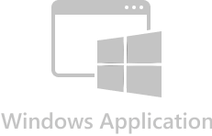
Native
android.widget
AndroidX libraries
Java/Kotlin APIs
UIKit
ARKit, AVKit, CarPlay, and dozens more
Obj-C/Swift APIs
Mac Catalyst
UIKit + AppKit
Dozens of frameworks
Obj-C/Swift APIs
Windows App SDK
WinUI 3
C++ APIs

Slide 16
What’s “in the box” and nearby?
Features
MVVM & XAML
Android, iOS, macOS, Windows
7 Layouts
44 Views
Maui.Essentials
Maui.Graphics
Xamarin.Forms Compat
CommunityToolkit.
Maui
Maui.Markup
Mvvm
New Capabilities
BlazorWebView
Border
Shadows
GraphicsView
MenuBar
Window/Multi-Window
Default theme
AppIcon
SplashScreen
Fonts
Images
Shell flyout templates
Changes from Xamarin
Color/Colors
Zero’d defaults
Namespace
More XAMLC
App Startup
Lifecycle Events
.NET workloads

Slide 17
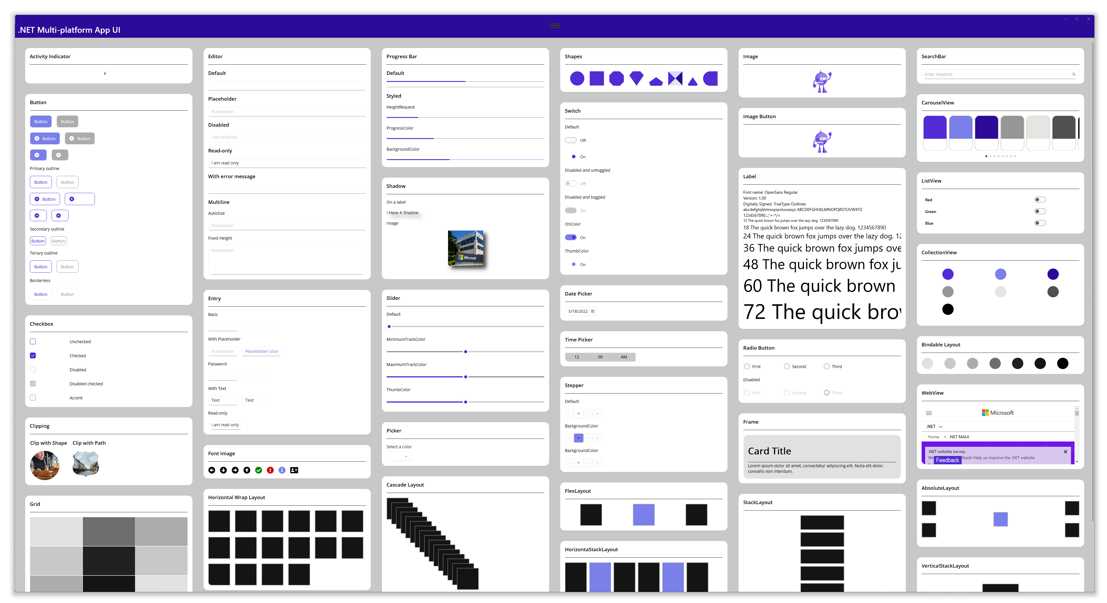
Over 50 Controls, Layouts and Views

Slide 18
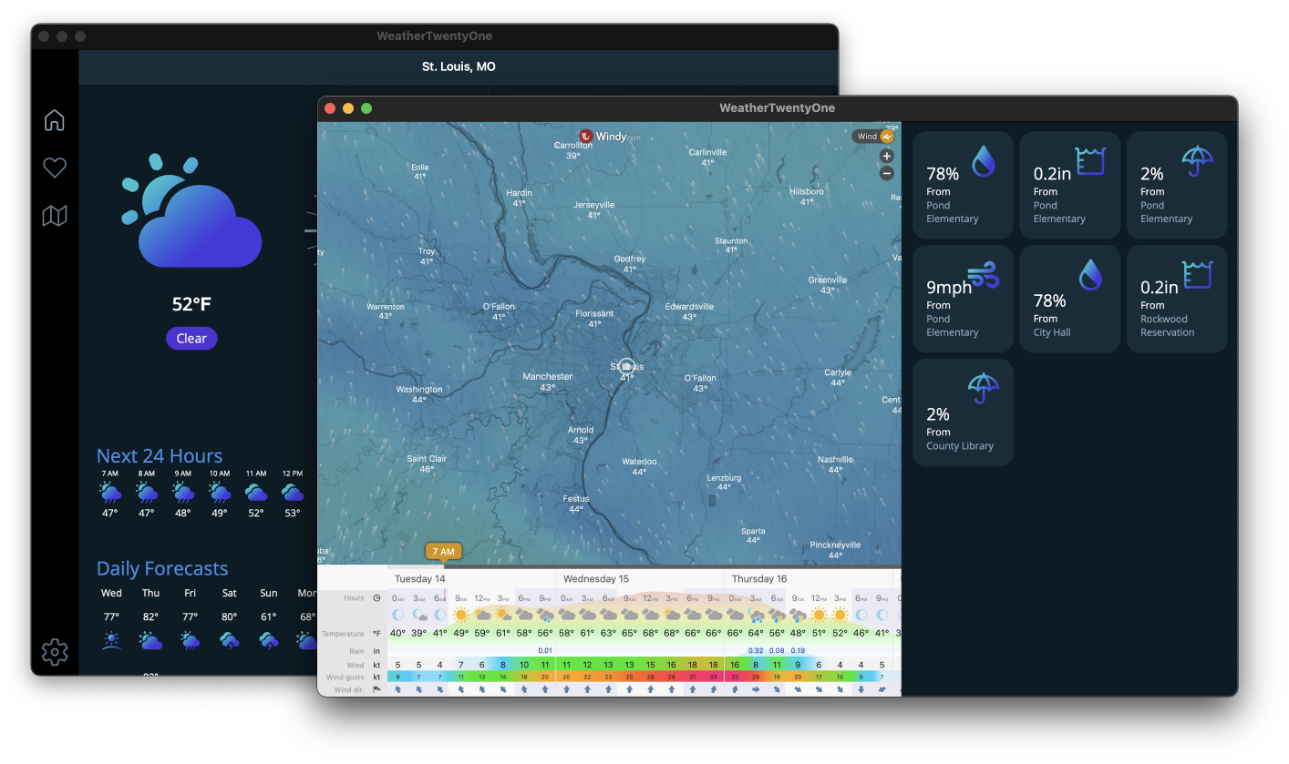
Multi-window

Slide 19
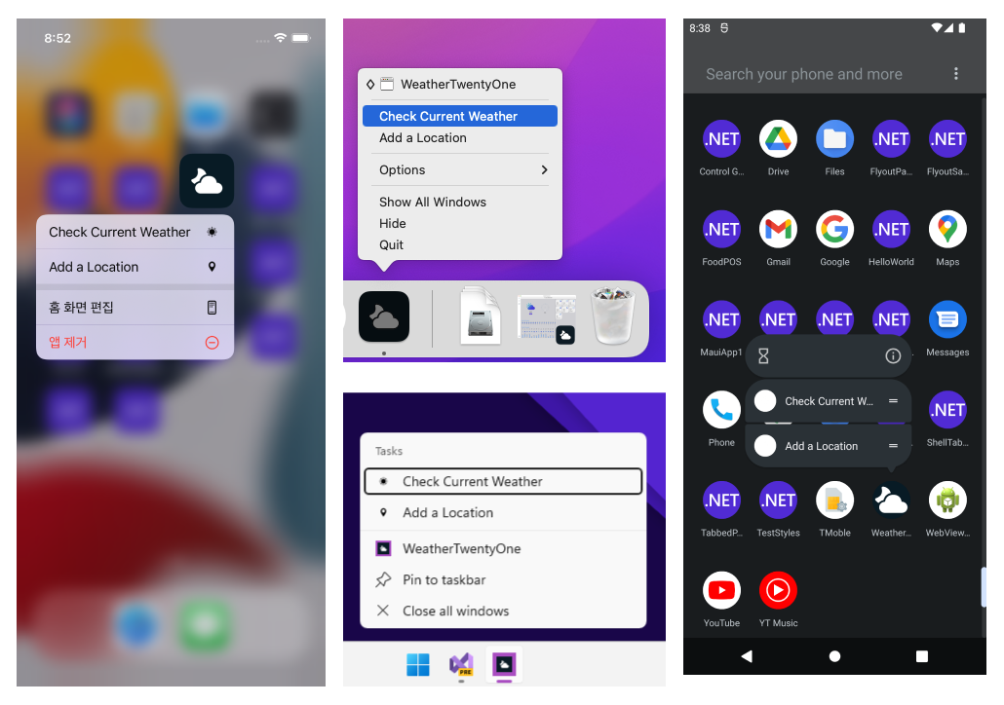
Beyond UI
Simple access to APIs
Access services and features of each platform
App actions
Clipboard
Device sensors
File system
Network
Notifications
+More

Slide 20


Blazor hybrid desktop apps
Blazor
Reuse UI components across native and web
Built on top of .NET Multi-platform App UI
Native app container & embedded controls
General availability in .NET 6
Can use native app
container & controls
.NET Multi-platform App UI
macOS
iOS
Notes:
Blazor has become a very popular way to write .NET web apps. We first supported Blazor on the server, then in the browser with WebAssembly, and now we’re extending it again, to enable you to write Blazor desktop apps in .NET 6. This enables you to create hybrid client apps, which combine web and native UI together in a native client application. It is primarily targeted at web developers that want provide rich client and offline experiences for their users.
Blazor hybrid apps is built on top of .NET Multi-platform App UI. It relies on that UI stack for a native application container and native controls (should you want to use them).
Although it will run anywhere .NET MAUI runs, for .NET 6, our primary focus for Blazor hybrid apps on desktop apps.

Slide 21
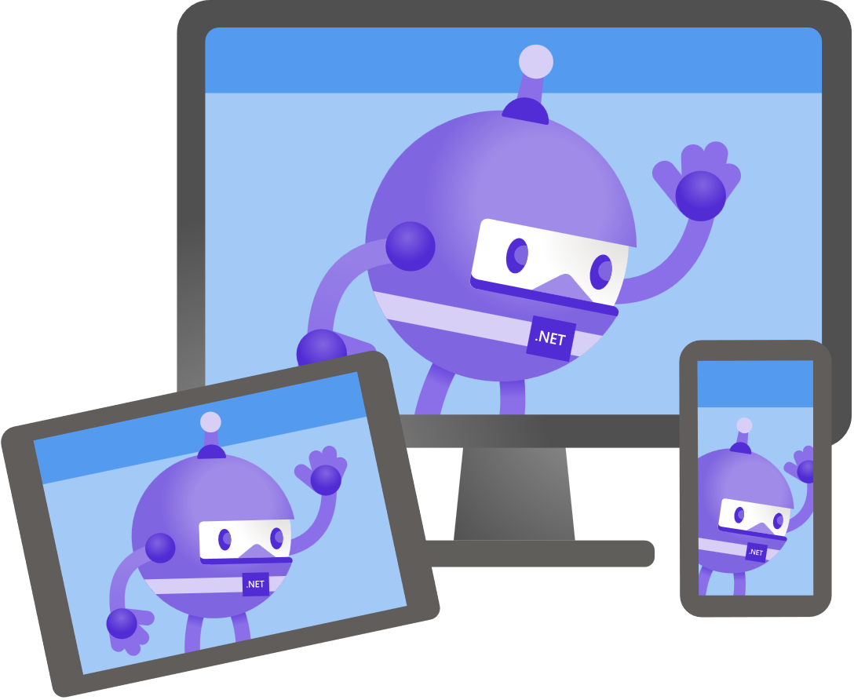
Hybrid
Bring native client capabilities to your web apps.
Notes:
Let’s talk about how we’re addressing those needs in .NET 6

Slide 22

Blazor – full stack web apps with .NET
Notes:
[M] Blazor lets you write full stack web apps with C# instead of JavaScript and it has taken the web world by storm. You can author reusable web UI components using C#, HTML and CSS and choose to run on the server or locally in the browser.
It has supported two models since spring 2020, Blazor Server, which is connected to a server, and Blazor WebAssembly which runs completely in the browser. Blazor has a shared component model across the server and the client browser. Depending on your application’s needs, you can choose the right model for you.

Slide 23
Blazor hybrid apps
Blazor
Reuse UI components across native and web
Native app container & embedded controls
Built on top of .NET Multi-platform App UI
BlazorWebview
.NET MAUI
WinUI
Mac
Catalyst
iOS
Android
macOS
iOS
Notes:
[M] With .NET MAUI, Blazor apps can now also run natively. This means you can create hybrid client apps, which combine web and native UI together in a single native client application so you can build rich client and offline experiences.
Blazor hybrid apps are built on top of .NET MAUI. You host Blazor components with the BlazorWebview which runs completely native.
Blazor hybrid relies on .NET MAUI for a native application container and native controls. Blazor hybrid apps have full access to the machine. You can do things like call native API's, access the file system, write multi-threaded applications – all with the high-performance and optimal memory consumption you get with .NET.

Slide 24
Choose your stack
BLAZOR
BLAZOR + .NET MAUI
.NET MAUI
C#, HTML, CSS
C#, XAML
Reach
Power
Site
PWA
Electron, CEF
Native App
with WebView
Native App
Web
Hybrid
Native
Notes:
[M] As you can see you have choices when it comes to native and web development with .NET. It comes down to reach and power and it’s a sliding scale. Depending on your application’s needs, you can choose the right mix for you. Fully web for the most reach, fully native for the richest native experiences, or a little bit of both with hybrid.

Slide 25
Try MAUI today!
Download: https://dotnet.microsoft.com/download
Visual Studio: https://visualstudio.com/preview
MAUI: https://dotnet.microsoft.com/apps/maui
Workshop: https://github.com/dotnet-presentations/dotnet-maui-workshop

